Slide 1



Volatile Sample Introduction Via Heated Pressurized Liquid Injection System (HPLIS®)

Slide 2
Conventional Liquid Sample Injection Systems
Introduction of semi-volatile liquid via automated liquid sampler and split/split less injector
Introduction of volatile liquid in GC via valve or vaporizer and split/splitless injector
  Rotary valve (Valco, Rheodyne)
  Diaphragm valve (Valco)
  Slider valve (ABB, Applied automation)
  Piston valve (M.A.T.)

Slide 3
Limitations of conventional liquid injection systems
Conventional Liquid sampling systems can have limitations when analyzing pressurized samples and/or with wide boiling point ranges.
Fractionation
Loss of light ends
Peak broadening
Injection speed effects
Temperature effects
Pressure limitations

Slide 4
Solution: HPLIS®
In 2001, Richard Tymko, founder of Trancendent Enerprises, recognized a need for a simple and reliable GC injection system for wide boiling range analytes (C2 to C30+)
Conventional injection methods at that time had limitations for these liquid samples with wide boiling ranges.
Working in consultation with other experts in the Alberta Petroleum/Petrochemical industry, he developed such an injection system.
The PLIS/HPLIS was designed, engineered, machined, assembled and tested entirely in Alberta
The initial prototypes for the unheated PLIS and the HPLIS® were released in 2002-2003 to Dow Chemicals for testing and evaluation.

Slide 5
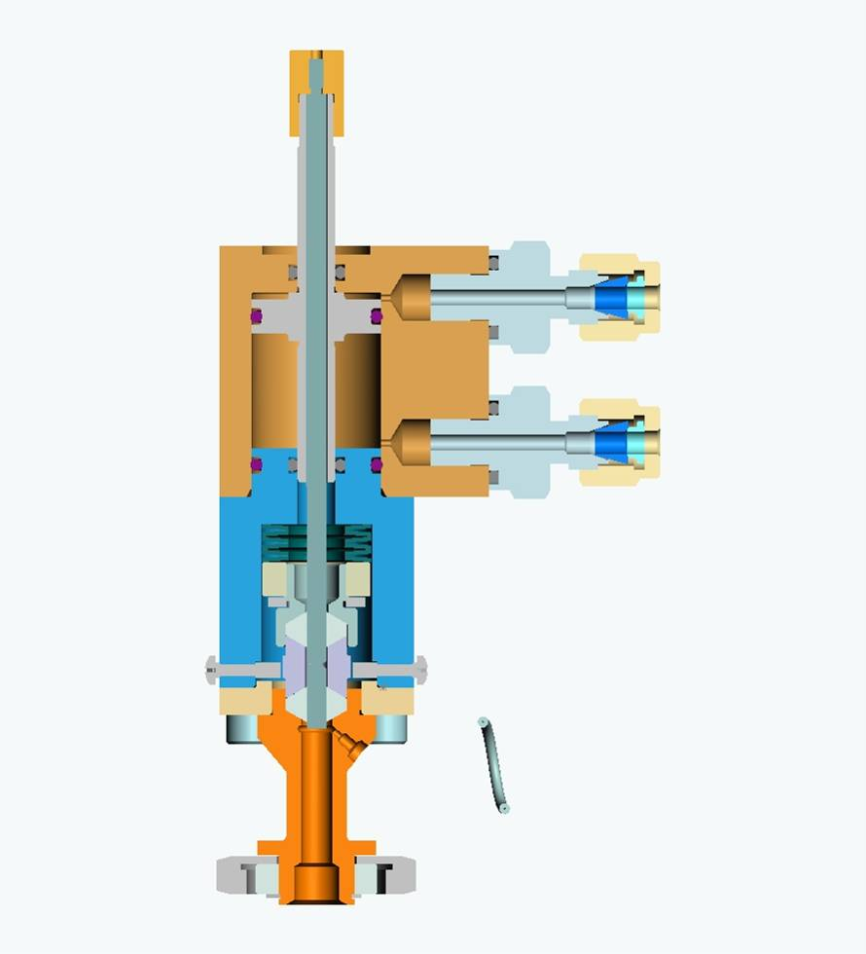
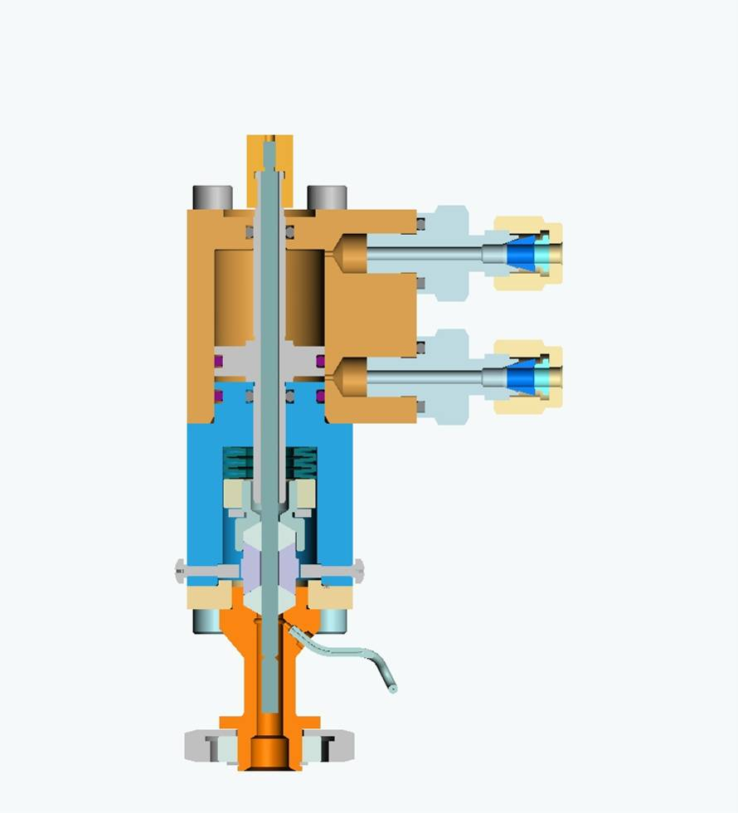
HPLIS® Initial design (PLIS)
Load Position Inject Position

Slide 6
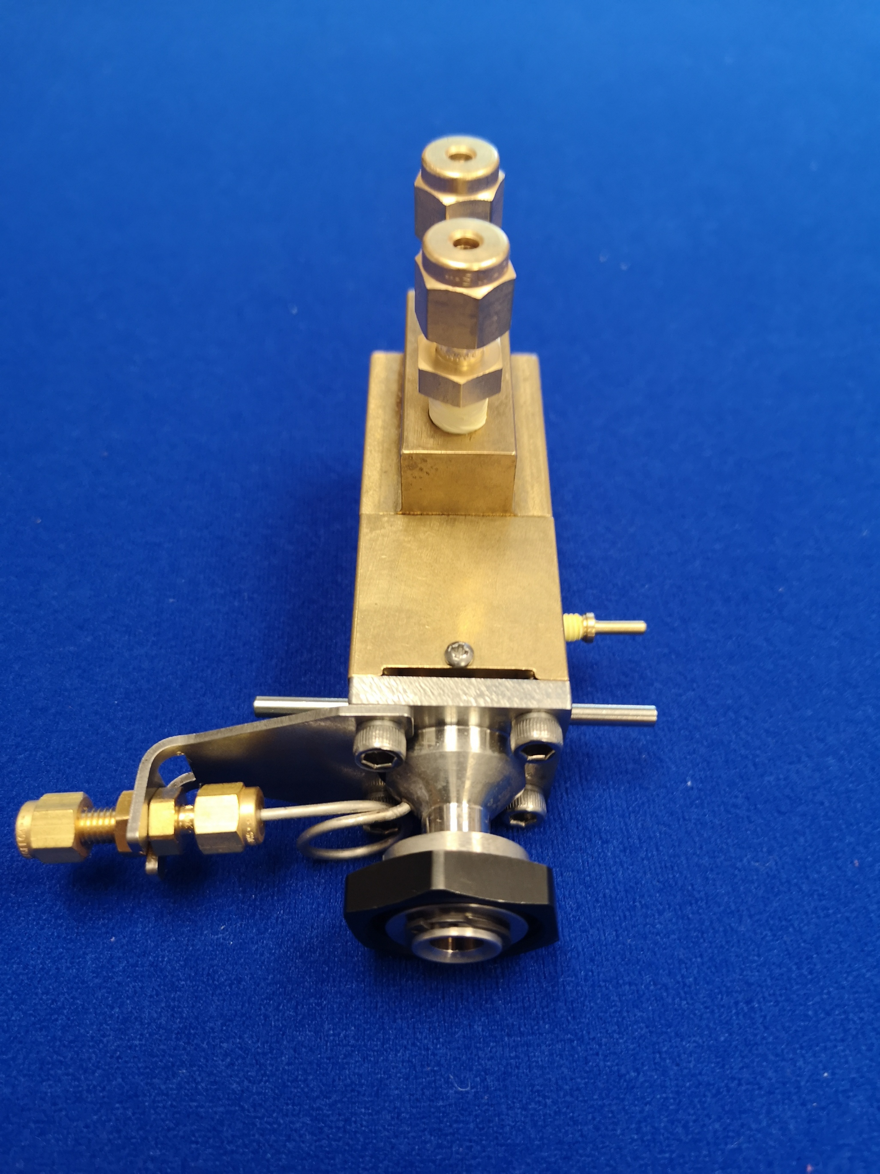
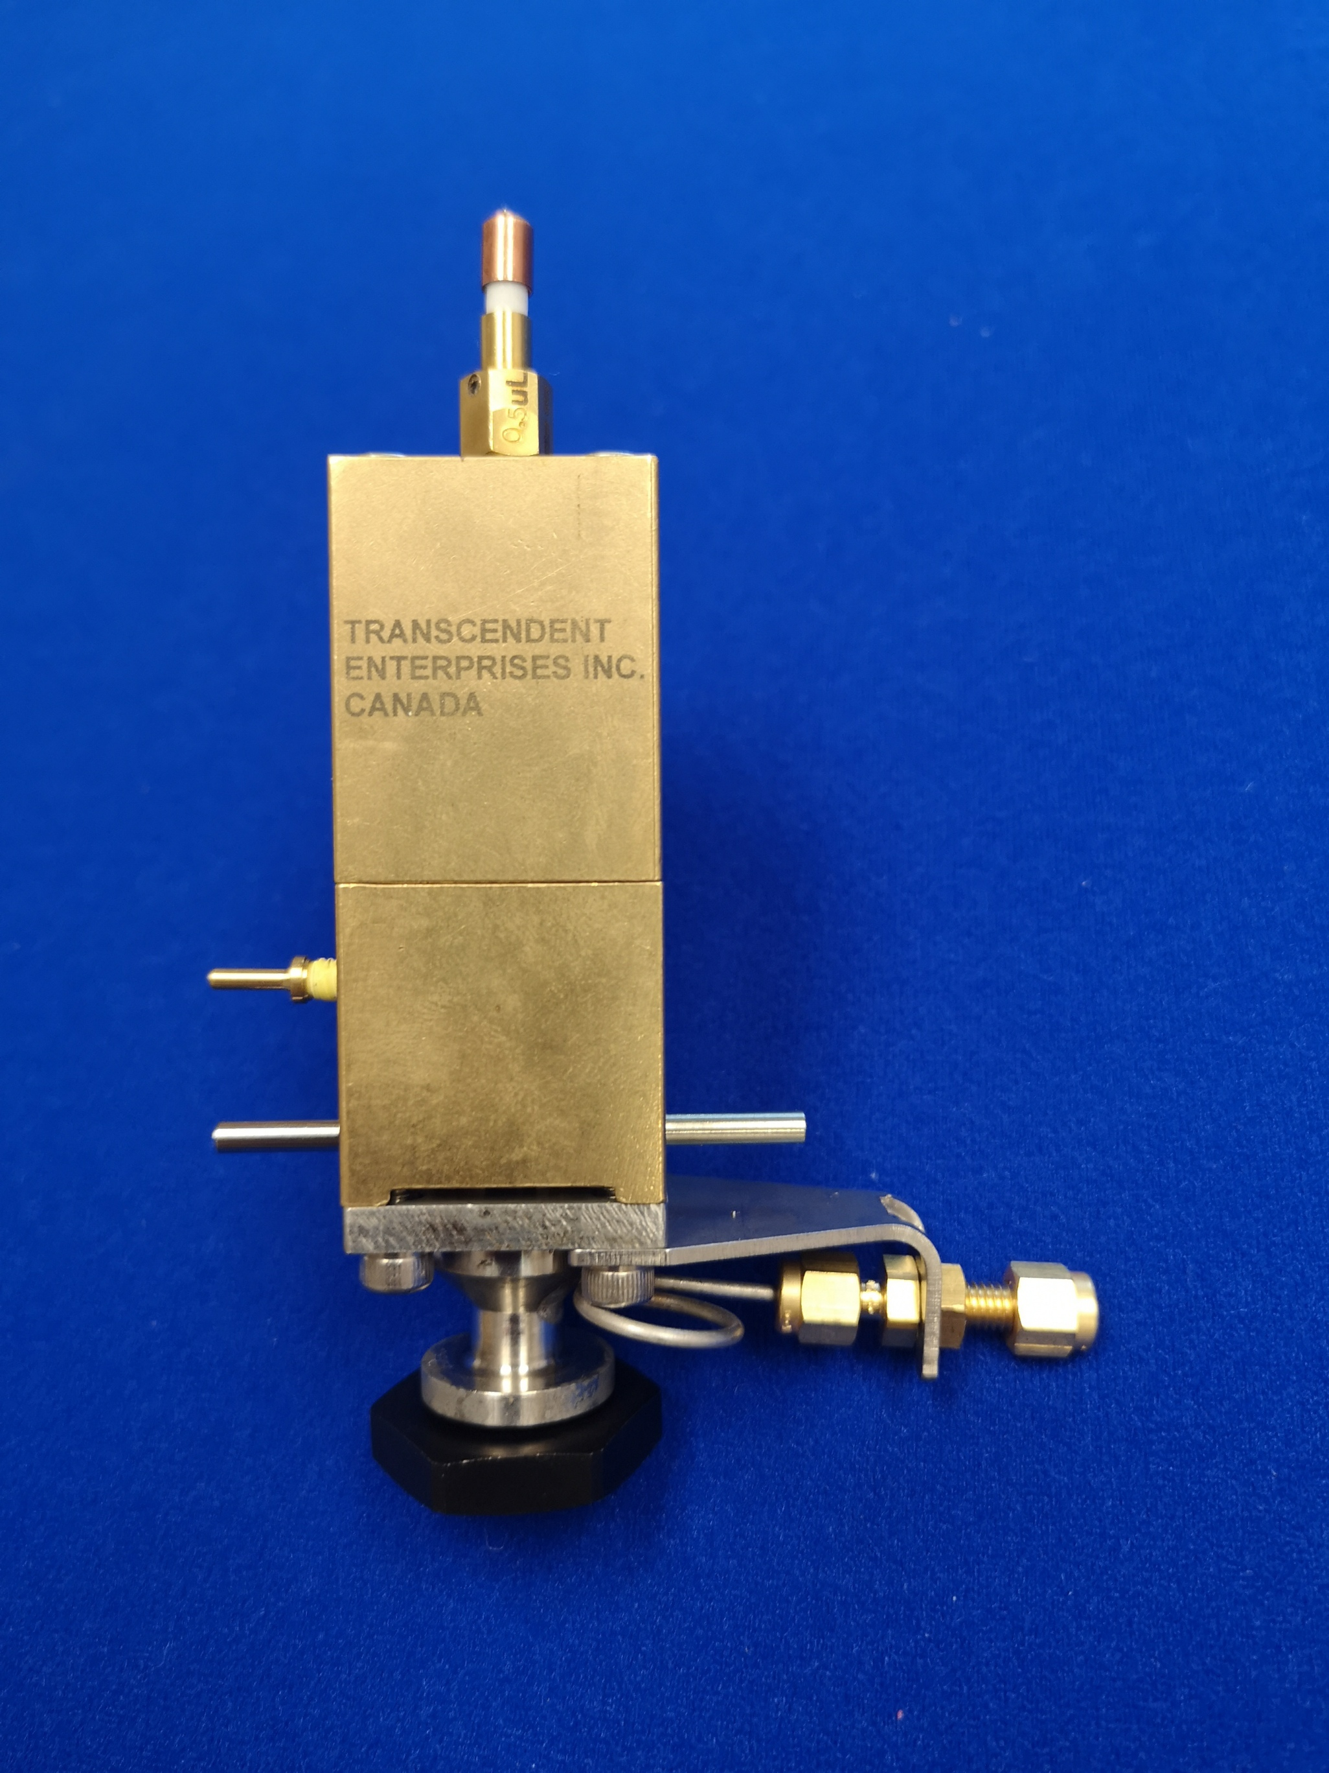
HPLIS® Current Generation

Slide 7
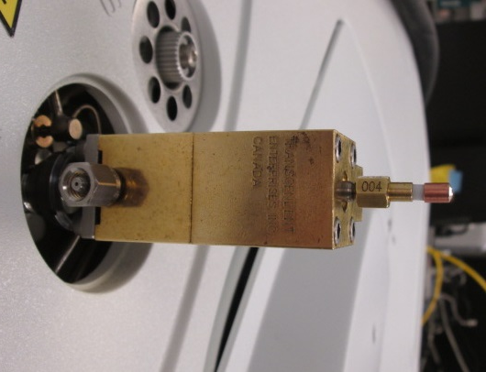
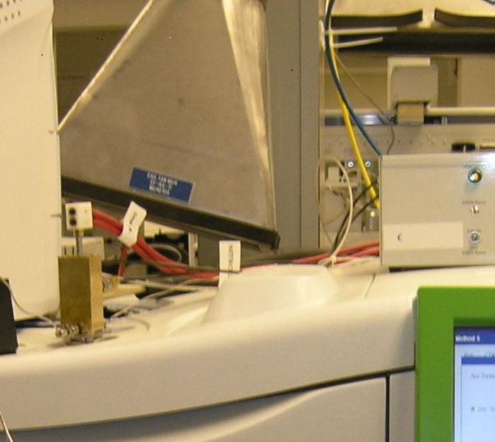
HPLIS® Mounted on a GC

Slide 8



HPLIS® HSTEM Design

Slide 9
HPLIS® KEY Features
Fast injection speed
High pressure of up to 1200 psig
Minimizes fractionation
Sample size from 0.06 uL to 12 uL
Heated sample groove
Low dead volume
Low maintenance and user-friendly
Simple/Rapid installation on any GC

Slide 10
HPLIS® Impact of injection speed on retention time
With actuation pressure at :
90 psig (39), 70 psig (41), and 45 psig (40))

Slide 11
HPLIS® Additional features
Sample Chamber Air purge
Maintains sample chamber at lower temperature
Increases longevity of seals
Vaporization Chamber Heated (Collar Optional)
Increases vaporization zone temperature
Extends molecular weight range

Slide 12
HPLIS® Heated collar and purge Temperature comparison
Conventional:
  Injector: 400C
  Vapourizer adapter temperature: 90C
  Sample chamber temperature: 54C
With collar:
  Injector: 400C
  Vapourizer adapter temperature: 200C (dialed in)
  Sample chamber temperature: 90C
  Sample chamber temperature with purge: 70C

Slide 13
HPLIS® Comparison of operating modes
Energized
Non-energized
Energized with collar
Non-energized with collar

Slide 14
HPLIS® Tested applications
Hydrocarbons
  LPG, NGL, Naptha, light condensate, heavy condensate, ASTM D-2887
  Organic Sulfurs - In liquid hydrocarbons
  Alcohols - In aqueous and hydrocarbons
  Aldehydes - In hydrocarbons
  Diesel in ethane
  Natural gas
Antioxidants in Olefins
  TBC in butadiene
Ethylene oxide and ethylene glycol
  Impurities in Ethylene Oxide (EO)
  Impurities in Glycols
Biphenyls, biphenyl oxides and ethyl biphenyls
Gaseous injections with PLIS
  Impurities in VCM
  Impurities in EO

Slide 15
HPLIS® ASTM D8003-15
ASTM D8003-15 Standard Test Method for Determination of Light Hydrocarbons and Cut Point Intervals in Live Crude Oils and Condensates by Gas Chromatography
This method utilizes direct sample introduction from a pressurized cylinder into the instrument via the HPLIS to eliminate evaporative losses.

Slide 16
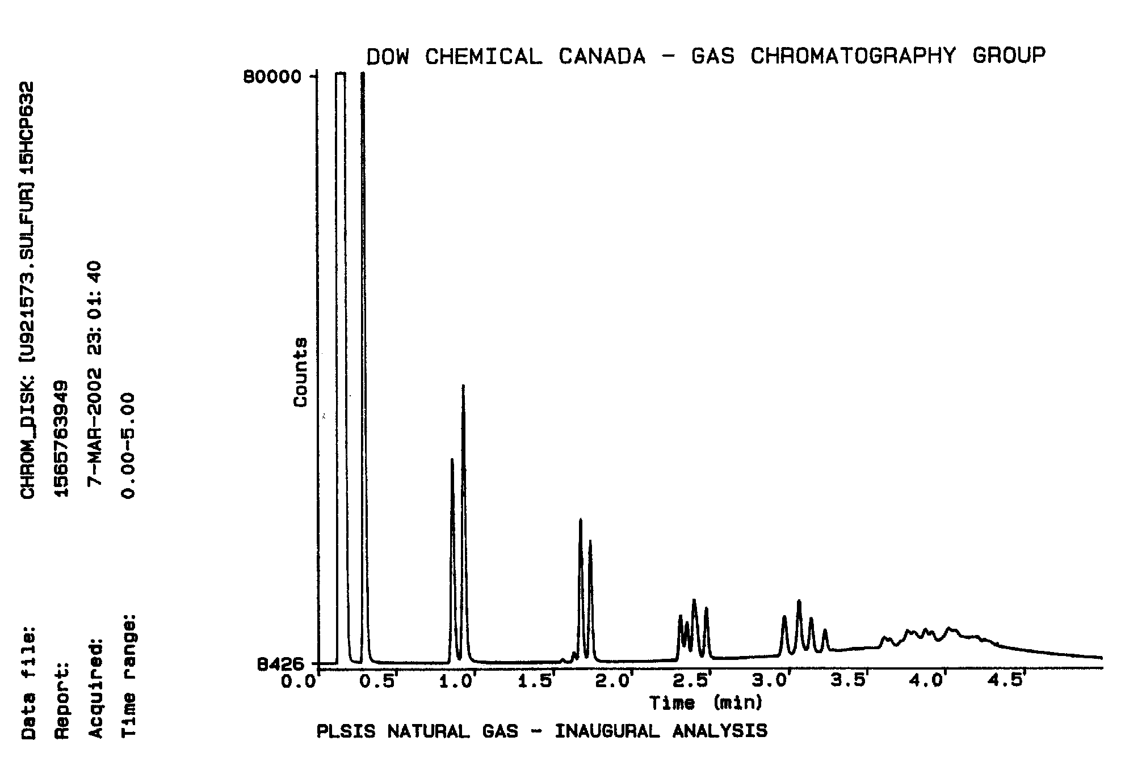
HPLIS® Natural Gas 2uL injected with PLIS

Slide 17
HPLIS® Repeatability
PLIS Quantitative Repeatabiliy
Natural Gas 2 ul Injection
Area Counts
Inj #
Ethane
Propane
i-Butane
1
121754
39884
10916
2
123649
40520
11033
3
121831
40223
10939
4
123160
40371
10933
5
122336
40152
10885
6
121277
39571
10763
7
120943
39479
10708
8
121000
39534
10700
9
120826
39492
10699
10
120956
39182
10610
11
119346
38687
10449
12
120108
38830
10510
13
121442
39213
10535
14
120292
39002
10494
15
121420
39315
10533
16
122217
39382
10568
17
122473
39489
10636
18
120791
38955
10488
19
120275
38846
10417
20
118799
38182
10270
Average
121245
39415
10654
Standard Deviation
1194.5
598.7
205.4
% RSD
1.0
1.5
1.9
Relative Precision at 95%
2.2
3.3
4.2

Slide 18
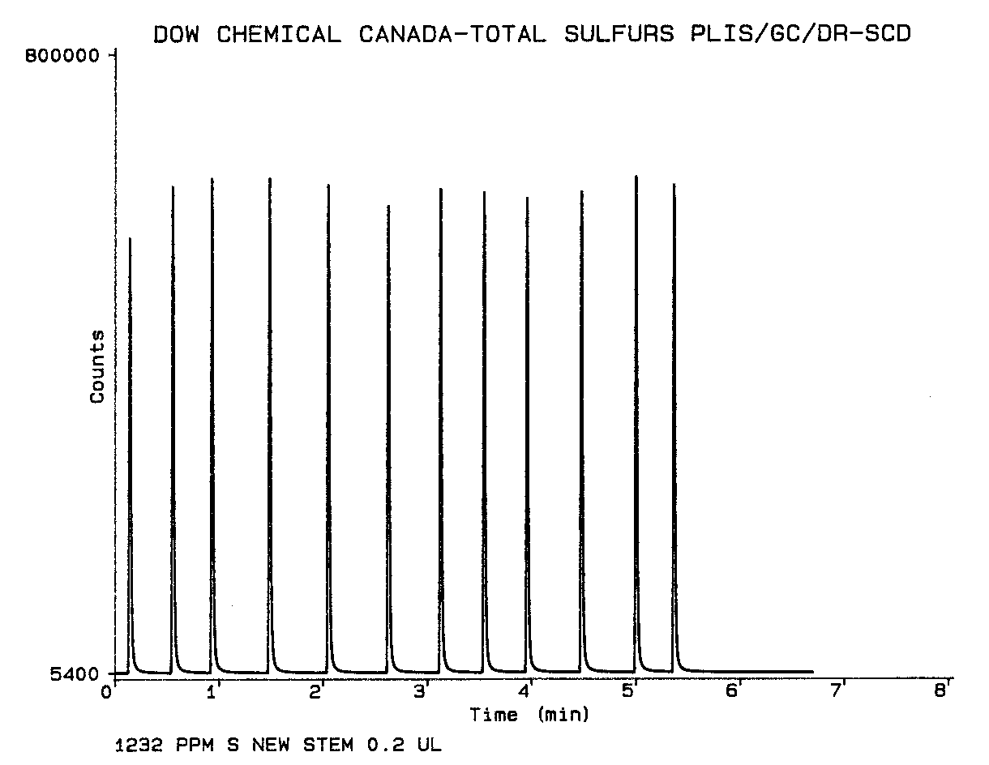
HPLIS® Replicate Sulfur STD using Sulfinert® treated PLIS

Slide 19
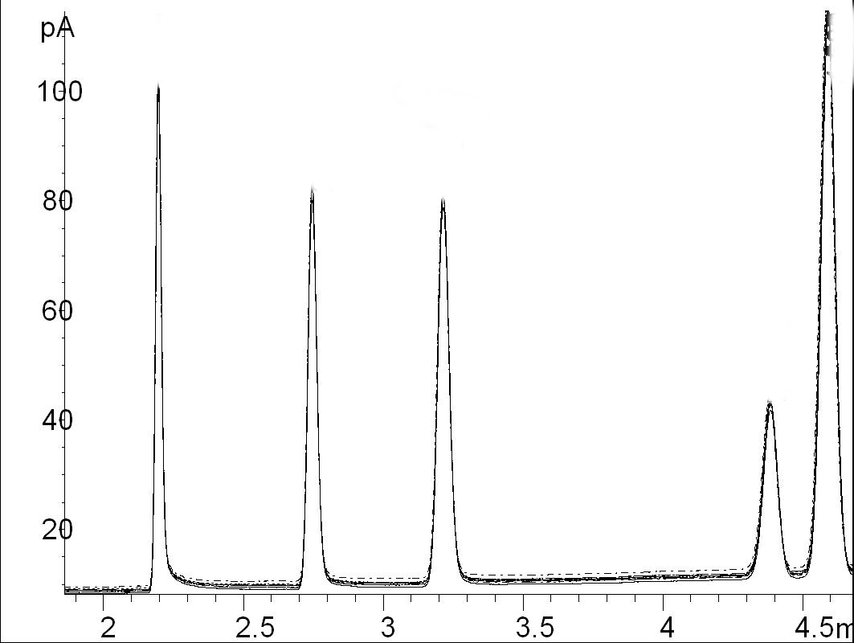
HPLIS® Overlay of 10 sequential alcohol Runs
Methanol
Ethanol
Propanol
Methyl Pentane
Hexane

Slide 20
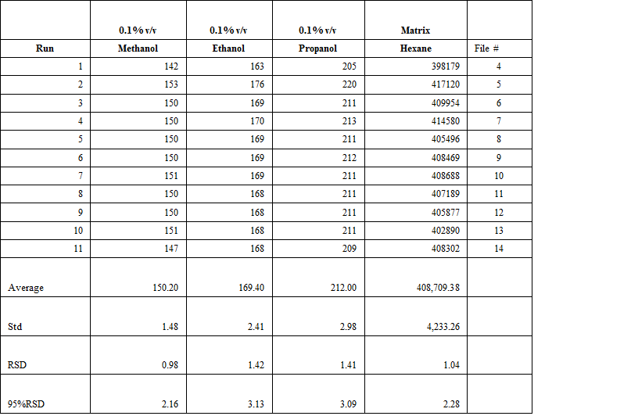
HPLIS® Repeatabilty of AlcohoLs

Slide 21
HPLIS® 4-Tert Butyl Catechol in Butadiene by PLIS gc
4-Tertiary Butyl Catechol

Slide 22
HPLIS® Comparison of injection methods
Relative Standard Deviation (%) from 5 Runs with Different Injection Techniques
 |  | 2 uL | 2 uL | 2 uL
 |  | Syringe | Valve | PLIS
Injected | Component | % RSD | % RSD | % RSD
Alcohol Standard | Methanol | 9.5 | 2.4 | 0.9
 | Ethanol | 9.5 | 2.4 | 0.3
 | Propanol | 10.8 | 2.4 | 0.3
C14, C15, C16 Standard | C14 | 20.9 | 15.2 | 2.6
 | C15 | 22.2 | 20.7 | 3.2
 | C16 | 22.7 | 11.5 | 4.1
Butadiene Sample | Acetaldehyde |  | 2.1 | 0.4
 | Propanal |  | 2.3 | 0.4
 | Ethanol |  | 1.7 | 0.2
 | Overall Average | 15.9 | 6.8 | 1.4

Slide 23
HPLIS® Current users
AITF, Edmonton
Agat Labs Calgary
Canmet Energy Devon
Dow Fort Saskatchewan
Dow Midland
Dow Freeport, Texas
Nova Chemicals, Sarnia
Nova Chemicals R/D, Calgary
Shell Research West Hollow, Texas
Shell Chemical, Netherlands
UOP, Chicago
Wasson. ECE, Colorado
And many more……

Slide 24
HPLIS® now and The Future
Trancendent Enterprises acquired by Chromatographic Specialties Inc in August 2019
Production has resumed
Consumables and new HPLIS® systems available through Chromatographic Specialties Inc.
Continued support through Chromatographic Specialties Inc.
No proposed changes to the HPLIS® injection unit itself
Potential enhancements to the power control module to facilitate ease of use.

Slide 25
HPLIS® Acknowledgements
Richard Tymko - Trancendent Enterprises Inc.
Ian Moss – Moss and Son Engineering
Jim Luong and Ronda Gras – Dow Fort Saskatchewan
Chris Goss –AITF
Dan Wispinski- AITF (Currently VUV Analytics)
CCQTA
ASTM
Perkin Elmer

